Slide 1
Digital Portfolio
STUDENT NAME: MD QUBAIB C
REGISTER NO AND NMID: 31924U09008
DEPARTMENT: B. C. A
COLLEGE: Mazharul uloom college [Autonomous]/ Thiruvallur UNIVERSITY

Slide 2
DIGITAL PORTFOLIO
1.A digital portfolio is a modern collection of a person’s work, experiences, and achievements stored in a digital format. 2. It is also called an e-portfolio or online portfolio. 3. It acts as a digital resume, highlighting both academic and professional skills. 4. A digital portfolio showcases projects, assignments, certificates, and creative works. 5. It uses multimedia elements such as images, videos, presentations, and documents.

Slide 3


AGENDA
Problem Statement
Project Overview
End Users
Tools and Technologies
Portfolio design and Layout
Features and Functionality
Results and Screenshots
Conclusion
Github Link
3/21/2024 Annual Review

Slide 4

PROBLEM STATEMENT
In the modern era, students and professionals face difficulty in showcasing their skills, achievements, and experiences using traditional paper-based resumes or portfolios. Traditional portfolios are often bulky, limited, and difficult to update or share. Employers and institutions increasingly demand a quick, professional, and accessible way to review an individual’s work.
There is a lack of a single platform where academic achievements, certifications, and personal projects can be displayed effectively. This creates a gap between talented individuals and the opportunities available.

Slide 5

PROJECT OVERVIEW
The project focuses on developing a Digital Portfolio, also known as an e-portfolio, which is an online platform to showcase a person’s skills, achievements, projects, and experiences. Unlike traditional paper-based portfolios, this digital solution is easy to update, accessible anytime, and globally shareable. The portfolio will include academic details, certifications, creative works, and personal projects in a professional format. The project aims to provide a user-friendly, attractive, and well-organized platform for students, job seekers, and professionals to present their work. It will be designed with modern tools (HTML, CSS, JS or platforms like Canva/Wix/WordPress) for a visually appealing presentation. The system will allow integration of multimedia such as images, videos, documents, and links to real projects.

Slide 6

WHO ARE THE END USERS?
1.Students – to showcase their academic achievements, projects, and extracurricular activities. 2. Job Seekers – to present skills, resumes, and certificates in a professional online format. 3. Freelancers – to display their creative work, designs, or coding projects for clients. 4. Teachers & Educators – to document teaching experience, research, and publications. 5. Professionals – to maintain a record of career growth and achievements.

Slide 7

TOOLS AND TECHNIQUES
1. HTML (HyperText Markup Language) – for creating the structure of the portfolio. 2. CSS (Cascading Style Sheets) – for designing and styling (colors, layouts, fonts). 3. JavaScript – for adding interactivity and dynamic features. 4. Canva / Figma – for creating graphics, banners, and portfolio design templates. 5. WordPress / Wix / Google Sites – for building no-code or low-code digital portfolios. 6. GitHub / Behance / LinkedIn – for publishing and showcasing work online.

Slide 8
POTFOLIO DESIGN AND LAYOUT
1. Clean & Simple Layout – Easy to navigate. 2. Consistent Theme Colors – Professional look. 3. Readable Fonts – Clear and attractive text. 4. Balanced Use of Images & Text – Not overcrowded. 5. Responsive Design – Works on all devices.
8

Slide 9
FEATURES AND FUNCTIONALITY
Navigation Menu – Easy access to sections.
Interactive Elements – Buttons, links, hover effects.
Responsive Design – Mobile & desktop friendly
Contact Form – Easy way to connect.
Project Showcase – Display work with images/videos.

Slide 10

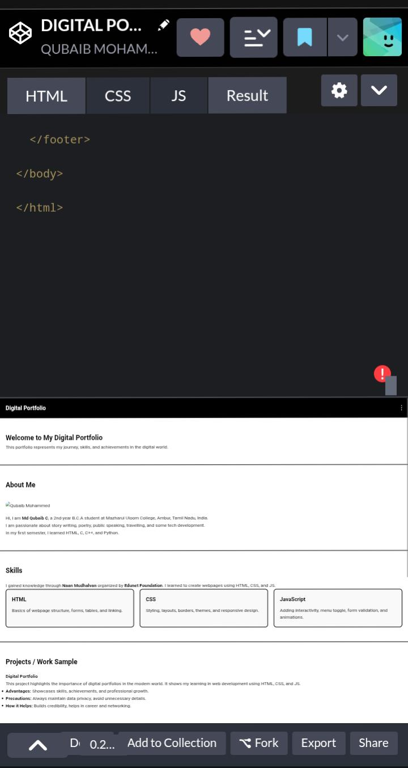
RESULTS AND SCREENSHOTS
1. Professional Online Presence – Builds credibility. 2. Boosts Personal Branding – Highlights individuality. 3. Easy Accessibility – Available anytime, anywhere.
3/21/2024 Annual Review
10

Slide 11
CONCLUSION
“A digital portfolio is more than just a collection of work; it reflects creativity, skills, and personality. It helps showcase strengths in a professional way and builds confidence. In today’s digital world, a well-designed portfolio opens doors to learning, growth, and future opportunities.”
11

